Slide 1
High-Speed Tracking with Kernelized Correlation Filters
João F. Henriques et al.

Slide 2
KCF: Prerequisites

Slide 3
Track by detection
Given a video V, and the ground-truth bounding box bbox(1) at the first frame f(1).
1. Treat bbox(1) as positive sample, and sample some patches in f(1) as negative samples.
2. Extract (HOG or CNN based)feature from positive and negative samples, train a classifier clas.
3. At the next frame f(2), use clas detect object:
A naïve method(not good, just for explanation) is using a slide window to get all possible object bounding box candidates, then treat the candidate with the highest confidence as the track/detection result at f(2), denoted as bbox(2).
4. Have f(2) and bbox(2), we can repeate process 1 and 2 to update our classifier clas since the object usually change appearance and gesture along time.
5. Similar to process 4, now we can deal with every frame in the video V.
You see that we need to update/train a classifier at every frame, which should be very time-consuming. The author accelerate the training with circulant matrix(see later).

Slide 4
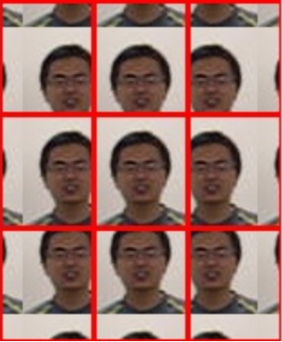
Circulant matrix
Instead of sampling some patches as negative samples, the author
cyclically shift the positive sample, to get negative samples, for example:
Positive sample, which is the ground-truth bounding box, is shown as
the centered image in the right picture.
Negative samples, are the images in the right picture except the
centered image.
The benefit of cyclic shift is that the training set X is a circulant matrix
in this way, which simplifies matrix calculation, specifically,
i. the close-form solution of training classifiers is much more simple.
ii. the close-form solution of predicting/classifying samples(detect
object) is much more simple.

Slide 5
KCF: train classifier

Slide 6




Ridge regression
Ridge regression(least square plus a regularization term):
, where
The closed-form solution:
This solution is time-consuming in practice. But if X is a circulant matrix, we can convert this time-consuming solution to a fast solution as below(inverse of F(w) is needed at the very end), where
i. all element of vector delta is 1
ii. hat and F(w) both are Fourier transform
iii. x is the generating vector(the first row or column) for the circulant matrix X
iv. y is the label vector
v. The division is also element-wise division.

Slide 7



Kernel trick
In ridge regression, we have
, where
The kernel trick is that, for f(z)
Replace z with
Replace w with . This is an assumption of kernel trick. Its benefit is shown as below.
Then, we get a new form of f(z).
ii’s benefit: Phi(x) may not be solved(e.g, gaussian), but k(z, x) is simple to solve.

Slide 8



Ridge regression with kernel trick. 1
In ridge regression with kernel trick, we have:
The closed-form solution:
,where
Similar to ridge regression, we want to convert this time-consuming solution to a fast solution, which requires K to be a circulant matrix. So the author proved a theorem as below:
Given a circulant matrix X, the corresponding kernel matrix K is circulant if the kernel function satisfies for any permutation matrix M.
Some nice kernels that satisfy the theorem:
Radial Basis Function kernels – e.g., Gaussian.
Dot-product kernels – e.g., linear, polynomial.
Additive kernels – e.g., intersection, and Hellinger kernels
Exponentiated additive kernels.
, where

Slide 9

Ridge regression with kernel trick. 2
In ridge regression with kernel trick, we have:
The closed-form solution:
,where
Having a proper kernel, we can convert this solution to a fast solution(inverse of hat is needed at the very end):
,where
i. all element of vector delta is 1
ii. hat is Fourier transform
iii. k is the generating vector(the first row or column) for the circulant matrix K
iv. y is the label vector
v. The division is also element-wise division.
, where

Slide 10
KCF: detect with classifier

Slide 11


Detect with ridge regression and kernel trick
a b
Considering 1-dimension case firstly, the signal s in pic.a moves a distance, reaching a certain position in pic.b. We know s’s position in pic.a, and we want to know its position in pic.b.

Slide 12



Detect with ridge regression and kernel trick
First, we cyclic shift s in pic.b to get a lot of candidates of s in pic.a. To get the cyclic shift candidates, we can multiply pic.b which is a vector, for example, […, 0, 0, 2, -2, 0, 0, 1, 1], denoted as z. The shift operator P shifts z by 1 unit, P^i shift z by i units. z(i)=P^i·z is the ith candidate. Hat y(i) is the confidence that P^i·z is the correct candidate which is exactly pic.a, rewriting all hat y(i) in matrix/vector form hat y.
Then, using property of convolution, we can solve hat y quickly with Fourier transform as below, where is the generating vector of circulant matrix K.
Denoting the candidate with the highest candidate as Hat y(n), Hat y(n) corresponds to P^n·z, which cyclic shifts z by n unit. So if we know the index of Hat y(n) in hat y, we know the position of our signal s suddenly.
There is no a lot of details on detect phase. Detail is showed in Exploiting the Circulant Structure of Tracking-by-detection with Kernels with the same author.

Slide 13
KCF: fast kernel correlation

Slide 14




Dot-product kernel
The solution for training ridge regression with kernel trick is
The solution for detecting is
Hat k and bar k both mean generating vector of K.
Calculating Hat k or bar k is the last standing computational bottleneck. So the author uses property of convolution again:
Denote dot-product kernels as for some functions g
Denote the generating vector of K as , then
, write in vector form ,where C(x) means a circulant matrix generated by x. For the vector form, apply property of convolution to get
,where * means complex-conjugate.

Slide 15



Gaussian kernel and multi-channel
Similar to dot-product kernel, for a gaussian kernel ,
we can calculate the generating vector of K with .
Till now, we only work with one channel data(eg. x, z symbols used before). To deal with multi-channel data, taking the gaussian kernel as an example, simply sum multiple channels:
, where c means cth-channel of x.
Pay attention that here multi-channel can not only be RGB channels, but also can be gradient orientation bins for HOG, feature maps for convolutional neural network, and so on.

Slide 16
KCF: show all results together & core code in MATLAB implementation

Slide 17
Show all results together
The solution for training ridge regression with kernel trick is
The solution for detecting is
Fast kernel correlation for calculating Hat k or bar k is
Hat k and bar k both mean generating vector of K. Here we use gaussian kernel.
You see how simple the final solution is and how fast it can be.

Slide 18
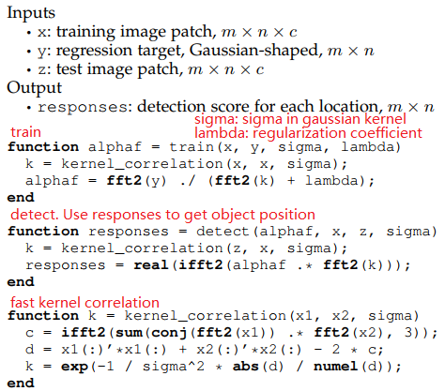
core code in MATLAB implementation
Full implementation at http://home.isr.uc.pt/~henriques/

